Slide 1
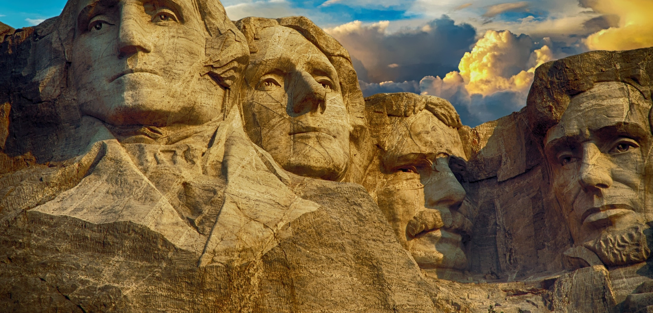
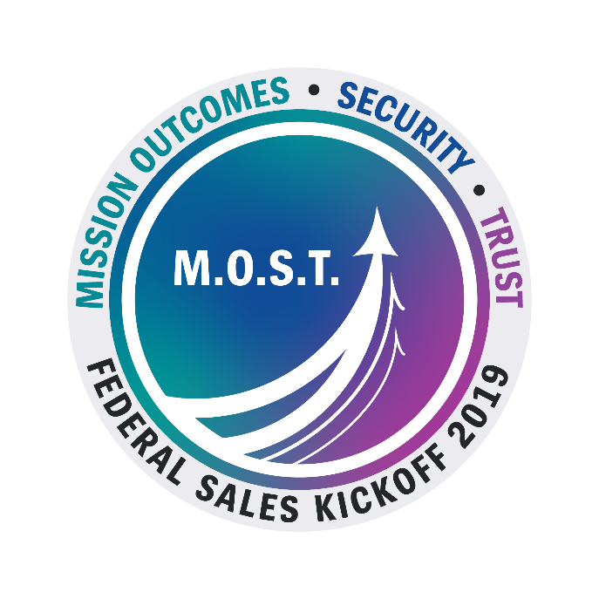
Federal Application Services
Securely Building the Future

Slide 2

2019 is a tipping point for modernization.
Notes:
•There has never been a better time to be at Unisys given the market trends.
•More specifically, our Apps Services Team is perfectly aligned with what the government is seeking today and over the next several years.
•The Apps Services Team Provides Software Development that modernizes and takes the government into the future.
•Federal legacy IT investments are becoming increasingly obsolete: many use outdated software languages and hardware parts that are unsupported. Agencies reported using several systems that have components that are, in some cases at least 50 years old. Examples include:
•Department of Defense uses 8 inch floppy disks in a legacy system that coordinates the operational functions of the nation’s nuclear forces.
•Department of Treasury uses assembly language code – a computer language initially used in the 1950;s and topically tied to hardware for which it was developed.
Additional Challenges:
•Significant duplication and redundancy of solutions;
•Increasing demands for robust security and data privacy;
•Lack of acquisition models that enable cloud-based software as a service offerings, or that separate capital expenditures from operational expenditure;
•Inability to leverage data that supports decision making while missions demand synthesis and analysis of data across agencies;
•An aging workforce and loss of expertise in legacy technologies as workers retire; and
•Obstacles to accessing new technology and innovation.
2019 is a Tipping Point
•A recent survey found that feds think we are in a tipping point for modernization but there is not a sense that agencies are preparing their workforces for new technologies.
•76% expect their IT modernization budgets to increase in fiscal year 2019.
•Yet just 28% of feds feel confident about their own employees’ ability to lead the charter of modernizing IT.
•Survey respondents say their agencies need to improve in the following areas:
•Improve threat detection, intelligence and management
•Implement modern architecture
•Reduce network complexity through automation and reusable solutions

Slide 3

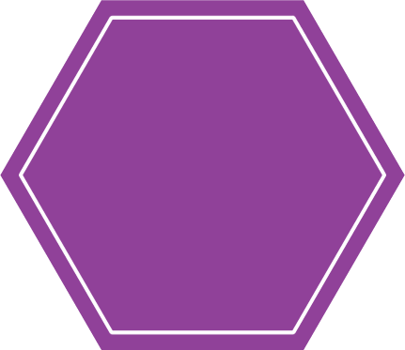
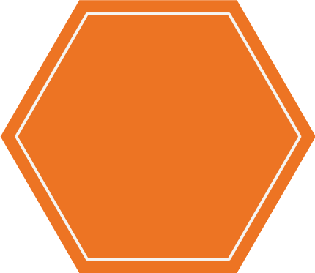


LeanGov™ ‒ The Unisys Way
Lean Maturity Models
PEOPLE
ACCELERATING
PROCESS
Delivery Playbooks
MISSION VALUE
TECHNOLOGY
Adaptive PMO

Slide 4

Notes:
HIppie Agile organization believes that there should not be any ordinance
They don't believe in documentation

Slide 5
4
2.2M
1
Notes:
7 Weekly deployments to production on TASPD TVS program during initial phase

Slide 6
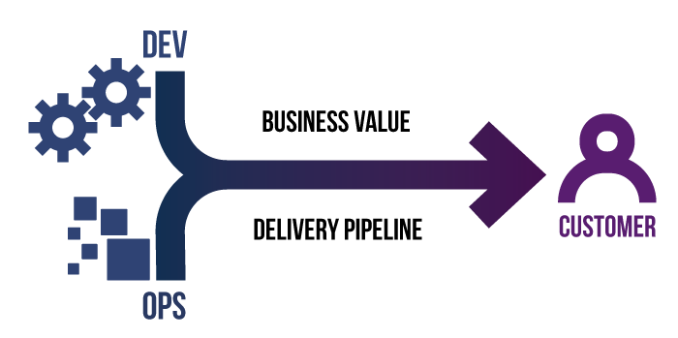


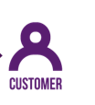

Unisys Platforms
DEV
SEC
OPS
Graphic Credit: Dimitris Papathomopoulos, InfoTech Solutions
Notes:
Speak to developer efficiency, resilience, portability, accelerating ATOs, self-healing

Slide 7
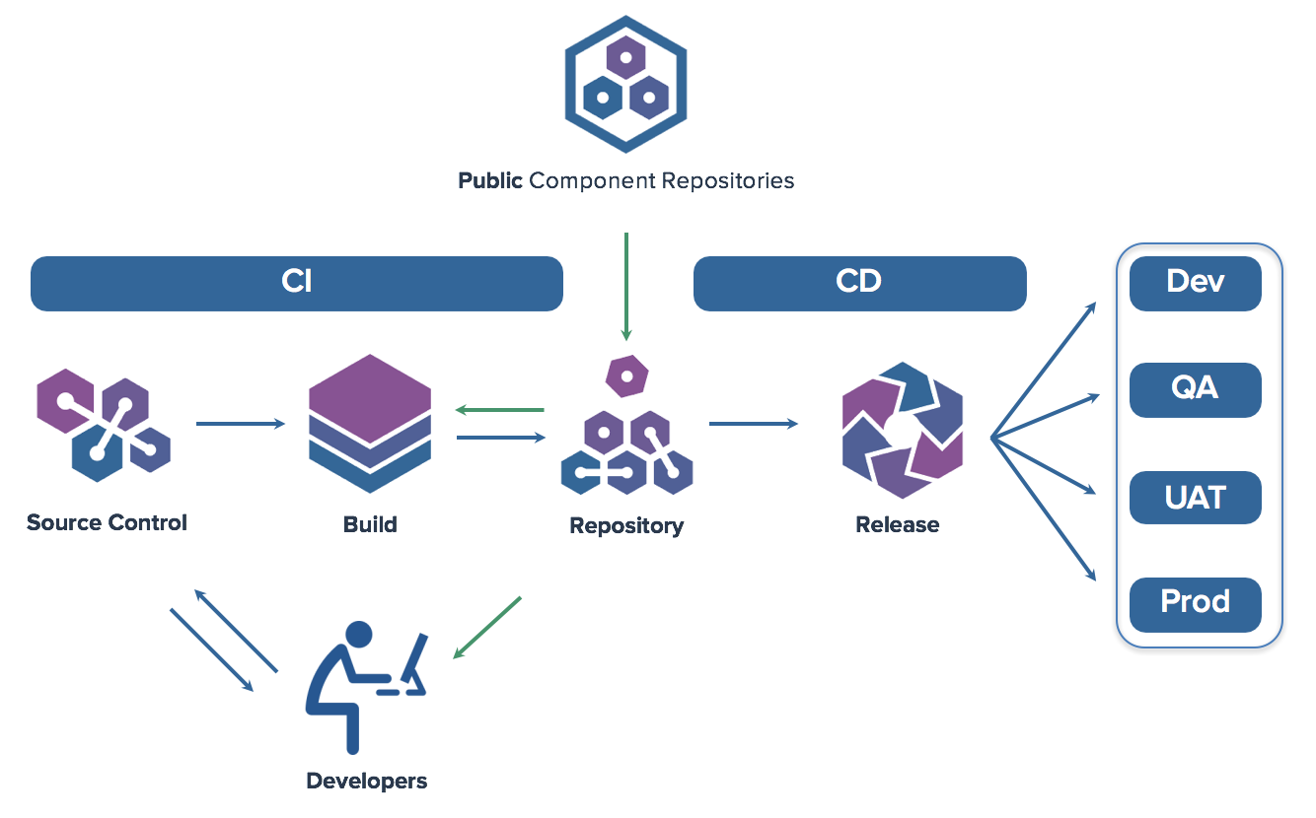
Securing DevOps
Policy
Graphic Credit: Sonatype

Slide 8

Incremental Modernization
Notes:
We recommend incremental modernization rather than "big bang" approaches
Big bang builds the whole new modern system, deploys it, and cuts users over to it all at the same time.
First problem is that it's simply not possible to know in advance all of the requirements of a modernized system. Latent issues and needs will emerge; and seeing the new application emerge will itself create new requirements.
During that work, there is no value, only cost
Big bang also incurs significant risk that 18 to 24 months or more later you deliver what was specified, not what was needed. There are operational risks and deployment risks because at the big cutover is the first time the system has ever been deployed and operated. Odds are very high that something will have been overlooked.
It's better to build and deploy small chunks of features, each providing some measurable value to the mission team, and each resulting in the decommissioning of some small chunk of the legacy
The customer sees recognizable value throughout the process
Delivery and operations procedures are impacted and change more slowly, allowing them to practice and improve steadily
The customer can better adapt to requirements that emerge during the transition and properly prioritize them
How do we Deliver Incremental Change?
We re-frame the portfolio and work away from applications and point-in-time projects to enduring software products with end-user apps and reusable services.
We focus on high-value end-user applications—improve the user's life
We initially connect that new app to services in the legacy code
We do it in a way that hides the services from the app—application programming interfaces (or APIs) provide the catalog of things the new app can do (get data, store data, compute things, send messages, etc.)--but the app doesn't know where the program code is that actually does those things. At first, it may be the old code, and then it will transition to the new code without the app knowing.
Little by little, more old code is replace and more end-user apps and features are built to consume services in a new way. It's an approach called the "strangler pattern"
As the program nears the end, the legacy components are decommissioned and all that's left is new applications and modern services.
FYI, you're probably going to hear the term MASA emerge over the next year—Mesh App and Service Architecture
Long Term Effects
No more need for mass modernization in the future
New apps and services can be built with the best languages and technologies at the time, and integrate with other services using common HTTP and web services
What about the Data?
We incrementally migrate, transform data as each application emerges
Data is synchronized in both directions, old-to-new, and new-to-old, while necessary to support both systems
Esp when modernizing ClearPath applications, Unisys Data Exchange is a valuable tool to support this

Slide 9


Incremental Modernization
Notes:
We recommend incremental modernization rather than "big bang" approaches
Big bang builds the whole new modern system, deploys it, and cuts users over to it all at the same time.
First problem is that it's simply not possible to know in advance all of the requirements of a modernized system. Latent issues and needs will emerge; and seeing the new application emerge will itself create new requirements.
During that work, there is no value, only cost
Big bang also incurs significant risk that 18 to 24 months or more later you deliver what was specified, not what was needed. There are operational risks and deployment risks because at the big cutover is the first time the system has ever been deployed and operated. Odds are very high that something will have been overlooked.
It's better to build and deploy small chunks of features, each providing some measurable value to the mission team, and each resulting in the decommissioning of some small chunk of the legacy
The customer sees recognizable value throughout the process
Delivery and operations procedures are impacted and change more slowly, allowing them to practice and improve steadily
The customer can better adapt to requirements that emerge during the transition and properly prioritize them
How do we Deliver Incremental Change?
We re-frame the portfolio and work away from applications and point-in-time projects to enduring software products with end-user apps and reusable services.
We focus on high-value end-user applications—improve the user's life
We initially connect that new app to services in the legacy code
We do it in a way that hides the services from the app—application programming interfaces (or APIs) provide the catalog of things the new app can do (get data, store data, compute things, send messages, etc.)--but the app doesn't know where the program code is that actually does those things. At first, it may be the old code, and then it will transition to the new code without the app knowing.
Little by little, more old code is replace and more end-user apps and features are built to consume services in a new way. It's an approach called the "strangler pattern"
As the program nears the end, the legacy components are decommissioned and all that's left is new applications and modern services.
FYI, you're probably going to hear the term MASA emerge over the next year—Mesh App and Service Architecture
Long Term Effects
No more need for mass modernization in the future
New apps and services can be built with the best languages and technologies at the time, and integrate with other services using common HTTP and web services
What about the Data?
We incrementally migrate, transform data as each application emerges
Data is synchronized in both directions, old-to-new, and new-to-old, while necessary to support both systems
Esp when modernizing ClearPath applications, Unisys Data Exchange is a valuable tool to support this

Slide 10
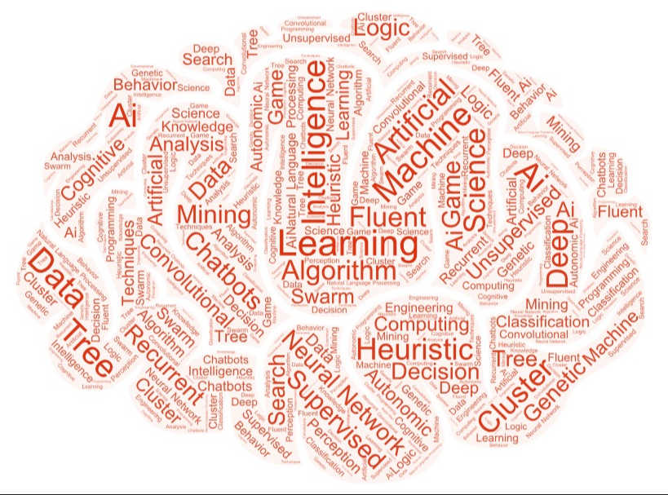

Demystifying AI
A technique for making machines mimic humans
A set of methods to “do AI”
A subset of ML

Slide 11
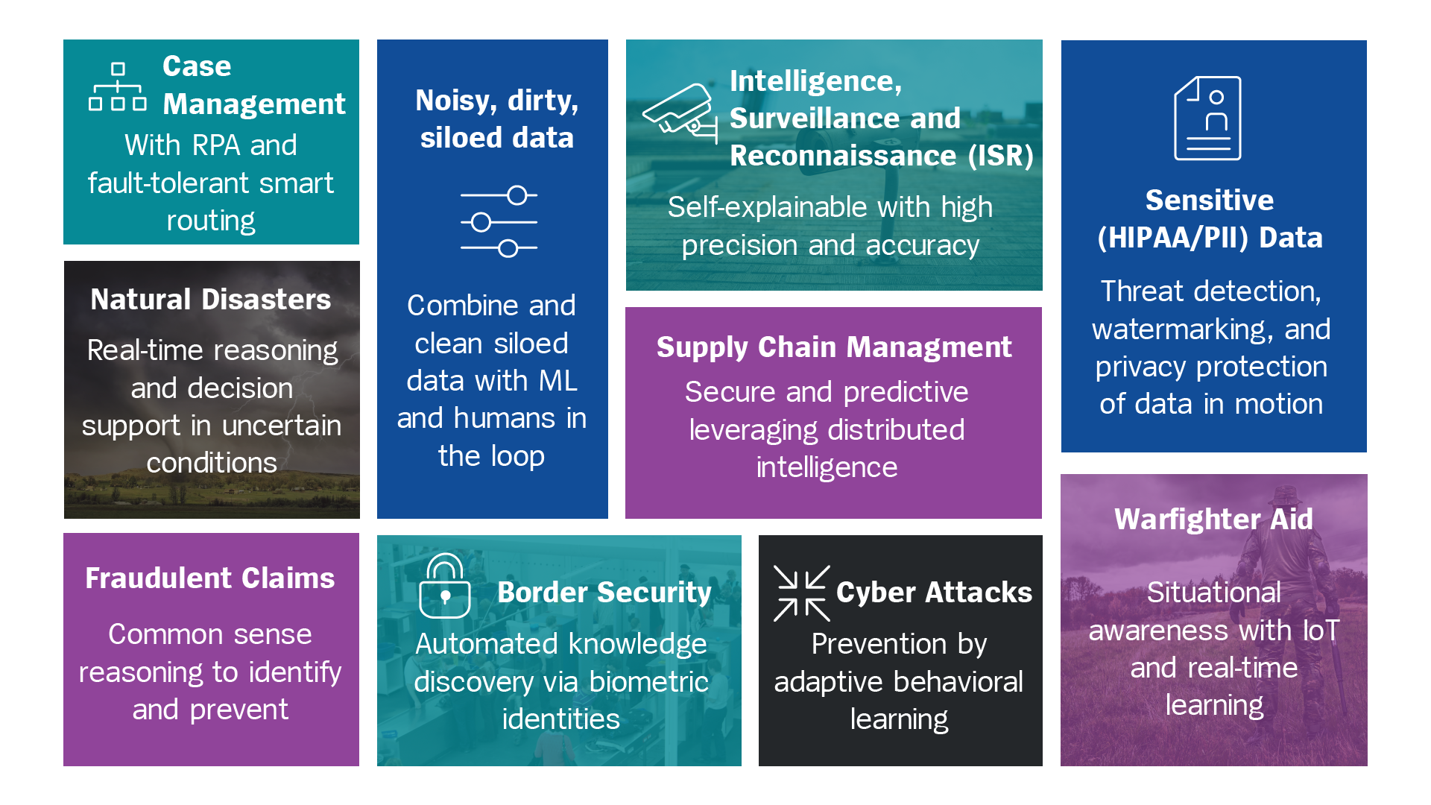
Federal Uses for AI

Slide 12

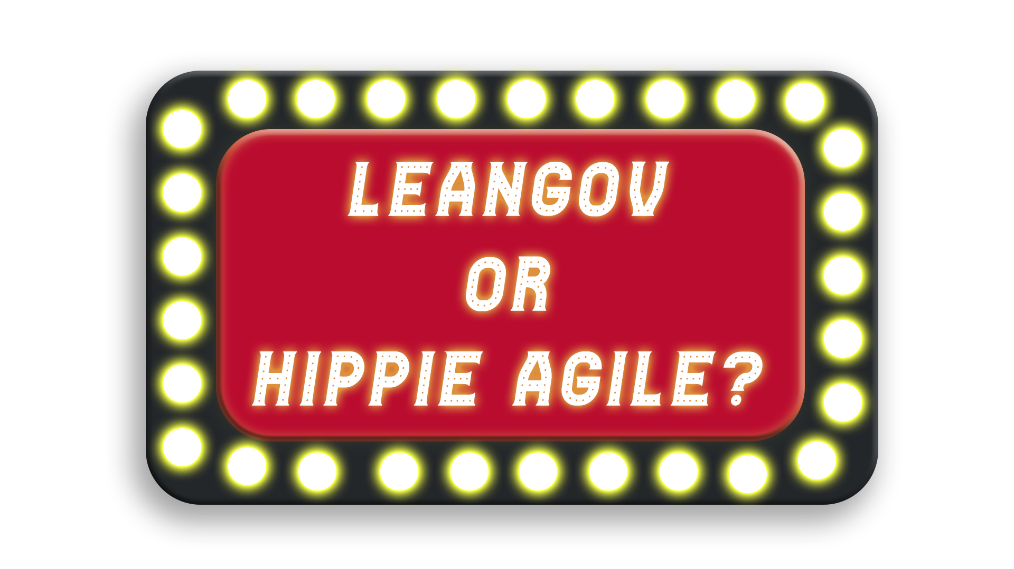

Hosted by Peter O’Donoghue

Slide 13
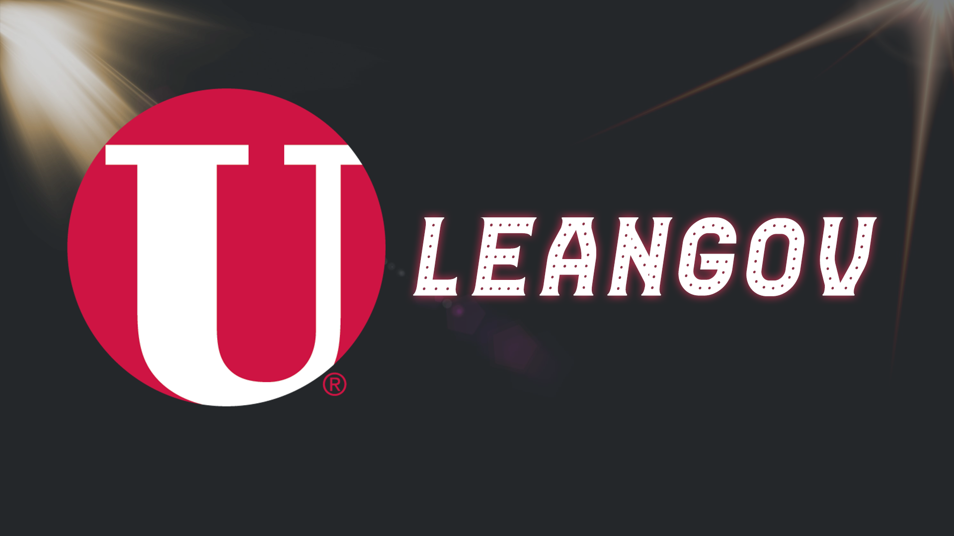
Adaptive PMO continually driving service improvement

Slide 14
Ditch documentation to go faster

Slide 15
No idea about the security about open source library I just downloaded

Slide 16
Large scale delivery

Slide 17
Our CI/CD pipeline is awesome when it’s working

Slide 18
Lean maturity models

Slide 19
New user experiences while modernizing applications incrementally

Slide 20
Not entirely sure of the overall direction of the program

